Slide 1


Name: Dharshannan Sugunan
Supervisor(s): Dr. Monica Marinescu, Dr. Michael Cornish

Slide 2
PRESENTATION CONTENTS
BACKGROUND INFORMATION
METHODOLOGY
INITIAL VALUE PROBLEM (ELECTROLYTE AND SOLID-STATE POTENTIALS)
1D Li-S MODEL WITHOUT PRECIPITATION/DISSOLUTION DYNAMICS
1D Li-S MODEL WITH PRECIPITATION/DISSOLUTION DYNAMICS
CONSECUTIVE CHARGE TESTS
GITT & NON-CONSTANT CURRENT TESTS
Slide: 2/26

Slide 3

BACKGROUND INFORMATION
Li-S batteries offer promise for advanced energy storage.
High theoretical energy density & cost-effective.
Challenges such as shuttle-effect & low Coulombic efficiency.
Employ numerical modelling to better understand these impediments.
Physics based models suffer from numerical instabilities (complex formulations).
Drives researchers to favor data-oriented models, trained via machine learning (lack of physical insight).
“Black-box” nature of other numerical solvers available:
Black
box
Output (No access to solver class)
GOAL: Re-vamp & optimize a novel solver tailored for 0D Li-S models (to implement spatial resolution).
Test developed solver with 1D Li-S model from literature [1] (Kumaresan’s model).
Subject results obtained to error metric tests to validate solver.
Further testing suggested from other authors.
Slide: 3/26

Slide 4
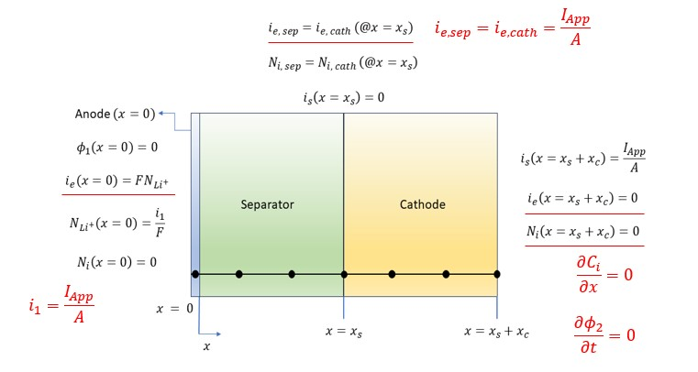
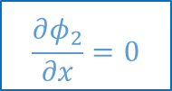
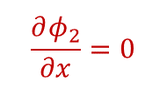

METHODOLOGY
1D Li-S MODEL COMPUTATIONAL DOMAIN
Li-S 1D Model Grid
$$\frac{∂φ_{2}}{∂x}=0$$
$$i_{e,sep}=i_{e,cath}$$
$$\frac{∂φ_{2}}{∂x}=0$$
Slide: 4/26

Slide 5
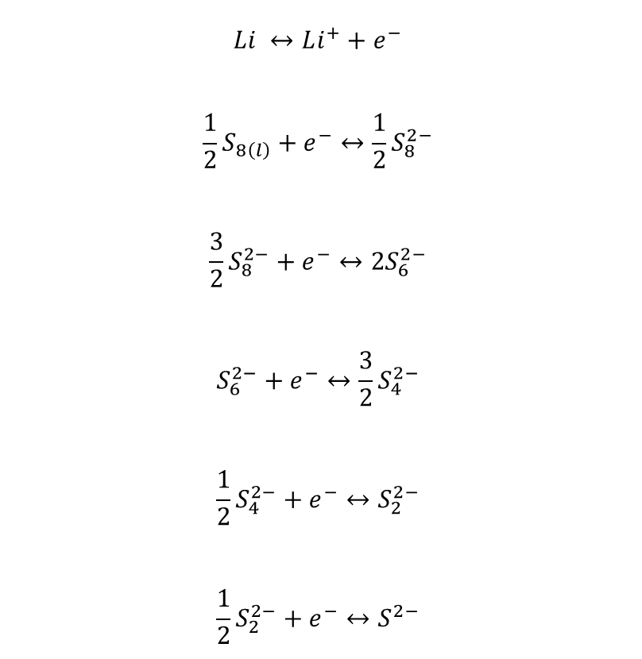
METHODOLOGY
1D Li-S MODEL COMPUTATIONAL DOMAIN
$$Li ↔Li^{+}+e^{−}$$
$$\frac{1}{2}S_{8\left(l\right)}+e^{−}↔\frac{1}{2}S_{8}^{2−}$$
$$\frac{3}{2}S_{8}^{2−}+e^{−}↔2S_{6}^{2−}$$
$$S_{6}^{2−}+e^{−}↔\frac{3}{2}S_{4}^{2−}$$
$$\frac{1}{2}S_{4}^{2−}+e^{−}↔S_{2}^{2−}$$
$$\frac{1}{2}S_{2}^{2−}+e^{−}↔S^{2−}$$
Li-S 1D Model Grid
$$i_{e,sep}=i_{e,cath}$$
Slide: 5/26

Slide 6
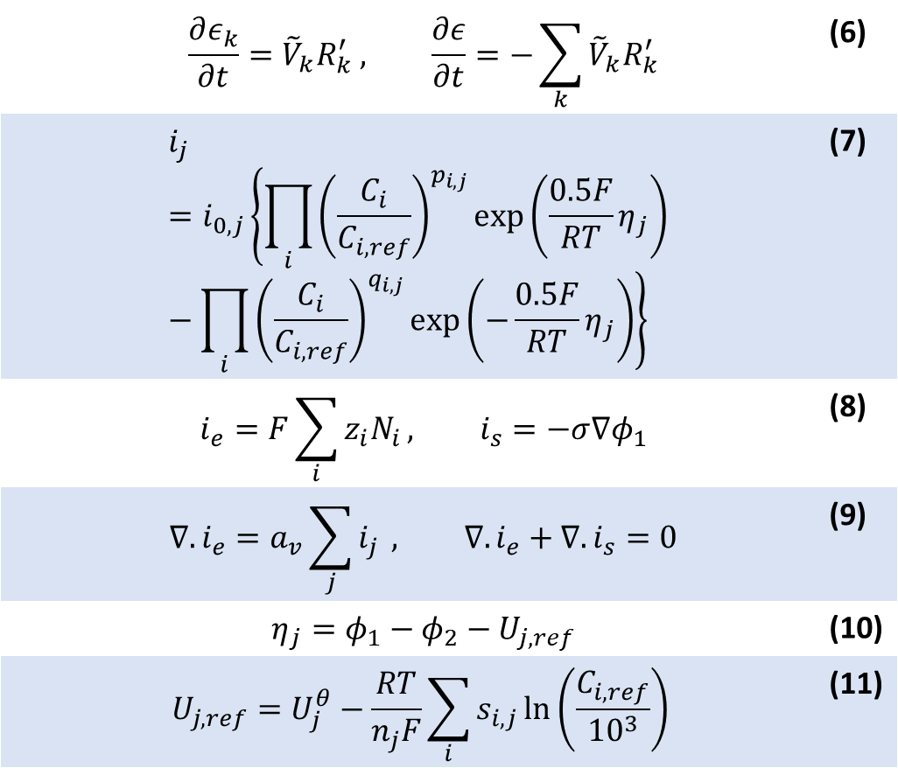
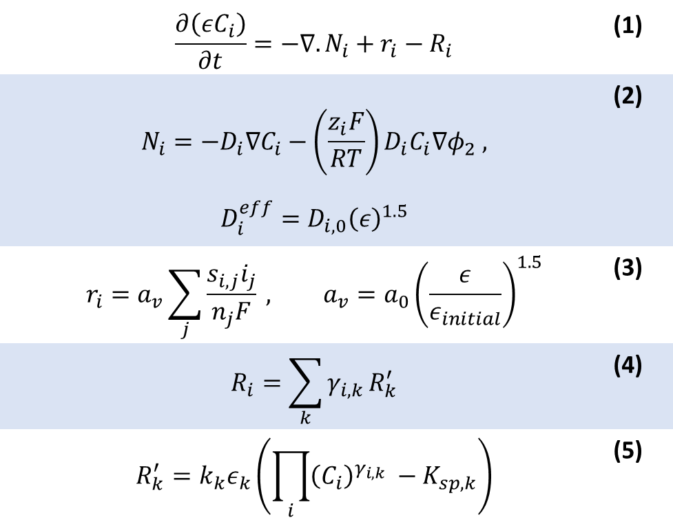
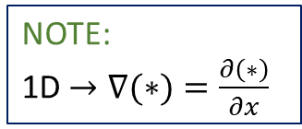
1D Li-S MODEL FORMULATION
 | $$\frac{∂\left(εC_{i}\right)}{∂t}=−∇.N_{i}+r_{i}−R_{i}$$ | (1)
 | $$N_{i}=−D_{i}∇C_{i}−\left(\frac{z_{i}F}{RT}\right)D_{i}C_{i}∇φ_{2} ,$$ $$D_{i}^{eff}=D_{i,0}{\left(ε\right)}^{1.5}$$ | (2)
 | $$r_{i}=a_{v}\sum_{j}{\frac{s_{i,j}i_{j}}{n_{j}F}} , a_{v}=a_{0}{\left(\frac{ε}{ε_{initial}}\right)}^{1.5}$$ | (3)
 | $$R_{i}=\sum_{k}{γ_{i,k}}R_{k}^{′}$$ | (4)
 | $$R_{k}^{′}=k_{k}ε_{k}\left(\prod_{i}{{\left(C_{i}\right)}^{γ_{i,k}}} −K_{sp,k}\right)$$ | (5)
 | $$\frac{∂ε_{k}}{∂t}={\tilde{V}}_{k}R_{k}^{′} , \frac{∂ε}{∂t}=−\sum_{k}{{\tilde{V}}_{k}R_{k}^{′}}$$ | (6)
 | $$i_{j}=i_{0,j}\left\{\prod_{i}{{\left(\frac{C_{i}}{C_{i,ref}}\right)}^{p_{i,j}}\exp\left(\frac{0.5F}{RT}η_{j}\right)} −\prod_{i}{{\left(\frac{C_{i}}{C_{i,ref}}\right)}^{q_{i,j}}\exp\left(−\frac{0.5F}{RT}η_{j}\right)}\right\}$$ | (7)
 | $$i_{e}=F\sum_{i}{z_{i}N_{i}}, i_{s}=−σ∇φ_{1}$$ | (8)
 | $$∇.i_{e}=a_{v}\sum_{j}{i_{j}} , ∇.i_{e}+∇.i_{s}=0$$ | (9)
 | $$η_{j}=φ_{1}−φ_{2}−U_{j,ref}$$ | (10)
 | $$U_{j,ref}=U_{j}^{θ}−\frac{RT}{n_{j}F}\sum_{i}{s_{i,j}\ln\left(\frac{C_{i,ref}}{{10}^{3}}\right) }$$ | (11)
NOTE:
1D $→∇(∗)=\frac{∂\left(∗\right)}{∂x}$
Slide: 6/26

Slide 7
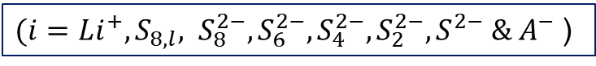
1D Li-S MODEL FORMULATION
 | $$\frac{∂\left(εC_{i}\right)}{∂t}=−∇.N_{i}+r_{i}−R_{i}$$ | (1)
 | $$N_{i}=−D_{i}∇C_{i}−\left(\frac{z_{i}F}{RT}\right)D_{i}C_{i}∇φ_{2} ,$$ $$D_{i}^{eff}=D_{i,0}{\left(ε\right)}^{1.5}$$ | (2)
 | $$r_{i}=a_{v}\sum_{j}{\frac{s_{i,j}i_{j}}{n_{j}F}} , a_{v}=a_{0}{\left(\frac{ε}{ε_{initial}}\right)}^{1.5}$$ | (3)
 | $$R_{i}=\sum_{k}{γ_{i,k}}R_{k}^{′}$$ | (4)
 | $$R_{k}^{′}=k_{k}ε_{k}\left(\prod_{i}{{\left(C_{i}\right)}^{γ_{i,k}}} −K_{sp,k}\right)$$ | (5)
 | $$\frac{∂ε_{k}}{∂t}={\tilde{V}}_{k}R_{k}^{′} , \frac{∂ε}{∂t}=−\sum_{k}{{\tilde{V}}_{k}R_{k}^{′}}$$ | (6)
 | $$i_{j}=i_{0,j}\left\{\prod_{i}{{\left(\frac{C_{i}}{C_{i,ref}}\right)}^{p_{i,j}}\exp\left(\frac{0.5F}{RT}η_{j}\right)} −\prod_{i}{{\left(\frac{C_{i}}{C_{i,ref}}\right)}^{q_{i,j}}\exp\left(−\frac{0.5F}{RT}η_{j}\right)}\right\}$$ | (7)
 | $$i_{e}=F\sum_{i}{z_{i}N_{i}}, i_{s}=−σ∇φ_{1}$$ | (8)
 | $$∇.i_{e}=a_{v}\sum_{j}{i_{j}} , ∇.i_{e}+∇.i_{s}=0$$ | (9)
 | $$η_{j}=φ_{1}−φ_{2}−U_{j,ref}$$ | (10)
 | $$U_{j,ref}=U_{j}^{θ}−\frac{RT}{n_{j}F}\sum_{i}{s_{i,j}\ln\left(\frac{C_{i,ref}}{{10}^{3}}\right) }$$ | (11)
$(i=Li^{+}, S_{8,l}, S_{8}^{2−},S_{6}^{2−}, S_{4}^{2−}, S_{2}^{2−}, S^{2−} \& A^{−}$)
Slide: 6/26

Slide 8
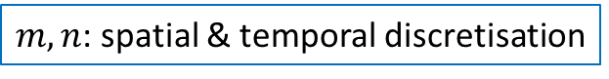

EQUATIONS DISCRETISATION
$m, n$: spatial & temporal discretisation
UNDERLYING EQUATIONS DISCRETISED VIA BACKWARDS EULER:
$${\left.\frac{df}{dt}\right|}_{n+1}=\frac{f_{n+1}−f_{n}}{δt}$$
Slide: 7/26

Slide 9
EQUATIONS DISCRETISATION
$m, n$: spatial & temporal discretisation
UNDERLYING EQUATIONS DISCRETISED VIA BACKWARDS EULER:
$${\left.\frac{df}{dt}\right|}_{n+1}=\frac{f_{n+1}−f_{n}}{δt}$$
Apply
$$D_{i}^{eff}=D_{i,0}{\left(ε\right)}^{1.5}$$
Discrete:
$$D_{i}^{eff}=D_{i,0}{\left(ε_{p}^{m,n+1}\right)}^{1.5}$$
Slide: 7/26

Slide 10

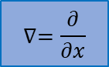

EQUATIONS DISCRETISATION
$m, n$: spatial & temporal discretisation
UNDERLYING EQUATIONS DISCRETISED VIA BACKWARDS EULER:
$${\left.\frac{df}{dt}\right|}_{n+1}=\frac{f_{n+1}−f_{n}}{δt}$$
$${∇.N}_{i}=∇.\left[−D_{i}∇C_{i}−\left(\frac{z_{i}F}{RT}\right)D_{i}C_{i}∇φ_{2}\right]$$
Apply
Apply
$$D_{i}^{eff}=D_{i,0}{\left(ε\right)}^{1.5}$$
Discrete:
$$D_{i}^{eff}=D_{i,0}{\left(ε_{p}^{m,n+1}\right)}^{1.5}$$
$$∇=\frac{∂}{∂x}$$
$$\frac{∂D_{i}^{eff}}{∂x}=1.5D_{i,0}\sqrt{ε_{p}^{m,n+1}}\left[\frac{ε_{p}^{m+1,n+1}−ε_{p}^{m,n+1}}{δx}\right]$$
Slide: 7/26

Slide 11
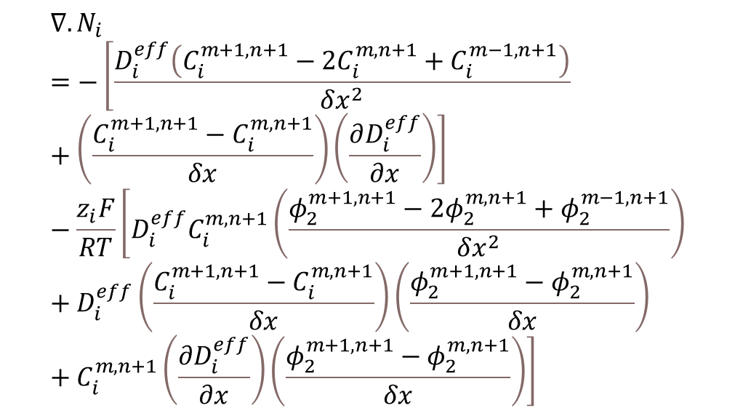
EQUATIONS DISCRETISATION
$m, n$: spatial & temporal discretisation
UNDERLYING EQUATIONS DISCRETISED VIA BACKWARDS EULER:
$${\left.\frac{df}{dt}\right|}_{n+1}=\frac{f_{n+1}−f_{n}}{δt}$$
$${∇.N}_{i}=∇.\left[−D_{i}∇C_{i}−\left(\frac{z_{i}F}{RT}\right)D_{i}C_{i}∇φ_{2}\right]$$
Apply
Discrete:
Apply
$$∇.N_{i}=−\left[\frac{D_{i}^{eff}\left(C_{i}^{m+1,n+1}−2C_{i}^{m,n+1}+C_{i}^{m−1, n+1}\right)}{δx^{2}}+\left(\frac{C_{i}^{m+1,n+1}−C_{i}^{m,n+1}}{δx}\right)\left(\frac{∂D_{i}^{eff}}{∂x}\right)\right]−\frac{z_{i}F}{RT}\left[D_{i}^{eff}C_{i}^{m,n+1}\left(\frac{φ_{2}^{m+1,n+1}−2φ_{2}^{m,n+1}+φ_{2}^{m−1,n+1}}{δx^{2}}\right)+D_{i}^{eff}\left(\frac{C_{i}^{m+1,n+1}−C_{i}^{m,n+1}}{δx}\right)\left(\frac{φ_{2}^{m+1,n+1}−φ_{2}^{m,n+1}}{δx}\right)+C_{i}^{m,n+1}\left(\frac{∂D_{i}^{eff}}{∂x}\right)\left(\frac{φ_{2}^{m+1,n+1}−φ_{2}^{m,n+1}}{δx}\right)\right]$$
$$D_{i}^{eff}=D_{i,0}{\left(ε\right)}^{1.5}$$
Discrete:
Substitute:
$$D_{i}^{eff}=D_{i,0}{\left(ε_{p}^{m,n+1}\right)}^{1.5}$$
$$∇=\frac{∂}{∂x}$$
$$\frac{∂D_{i}^{eff}}{∂x}=1.5D_{i,0}\sqrt{ε_{p}^{m,n+1}}\left[\frac{ε_{p}^{m+1,n+1}−ε_{p}^{m,n+1}}{δx}\right]$$
Slide: 7/26

Slide 12

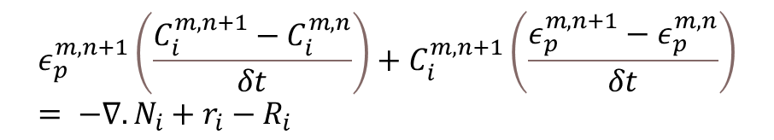
EQUATIONS DISCRETISATION
$m, n$: spatial & temporal discretisation
UNDERLYING EQUATIONS DISCRETISED VIA BACKWARDS EULER:
$${\left.\frac{df}{dt}\right|}_{n+1}=\frac{f_{n+1}−f_{n}}{δt}$$
Apply
$$∇.N_{i}=−\left[\frac{D_{i}^{eff}\left(C_{i}^{m+1,n+1}−2C_{i}^{m,n+1}+C_{i}^{m−1, n+1}\right)}{δx^{2}}+\left(\frac{C_{i}^{m+1,n+1}−C_{i}^{m,n+1}}{δx}\right)\left(\frac{∂D_{i}^{eff}}{∂x}\right)\right]−\frac{z_{i}F}{RT}\left[D_{i}^{eff}C_{i}^{m,n+1}\left(\frac{φ_{2}^{m+1,n+1}−2φ_{2}^{m,n+1}+φ_{2}^{m−1,n+1}}{δx^{2}}\right)+D_{i}^{eff}\left(\frac{C_{i}^{m+1,n+1}−C_{i}^{m,n+1}}{δx}\right)\left(\frac{φ_{2}^{m+1,n+1}−φ_{2}^{m,n+1}}{δx}\right)+C_{i}^{m,n+1}\left(\frac{∂D_{i}^{eff}}{∂x}\right)\left(\frac{φ_{2}^{m+1,n+1}−φ_{2}^{m,n+1}}{δx}\right)\right]$$
$$\frac{∂\left(εC_{i}\right)}{∂t}= −∇.N_{i}+r_{i}−R_{i}$$
Discrete:
$$ε_{p}^{m,n+1}\left(\frac{C_{i}^{m,n+1}−C_{i}^{m,n}}{δt}\right)+C_{i}^{m,n+1}\left(\frac{ε_{p}^{m,n+1}−ε_{p}^{m,n}}{δt}\right)= −∇.N_{i}+r_{i}−R_{i}$$
Slide: 8/26

Slide 13
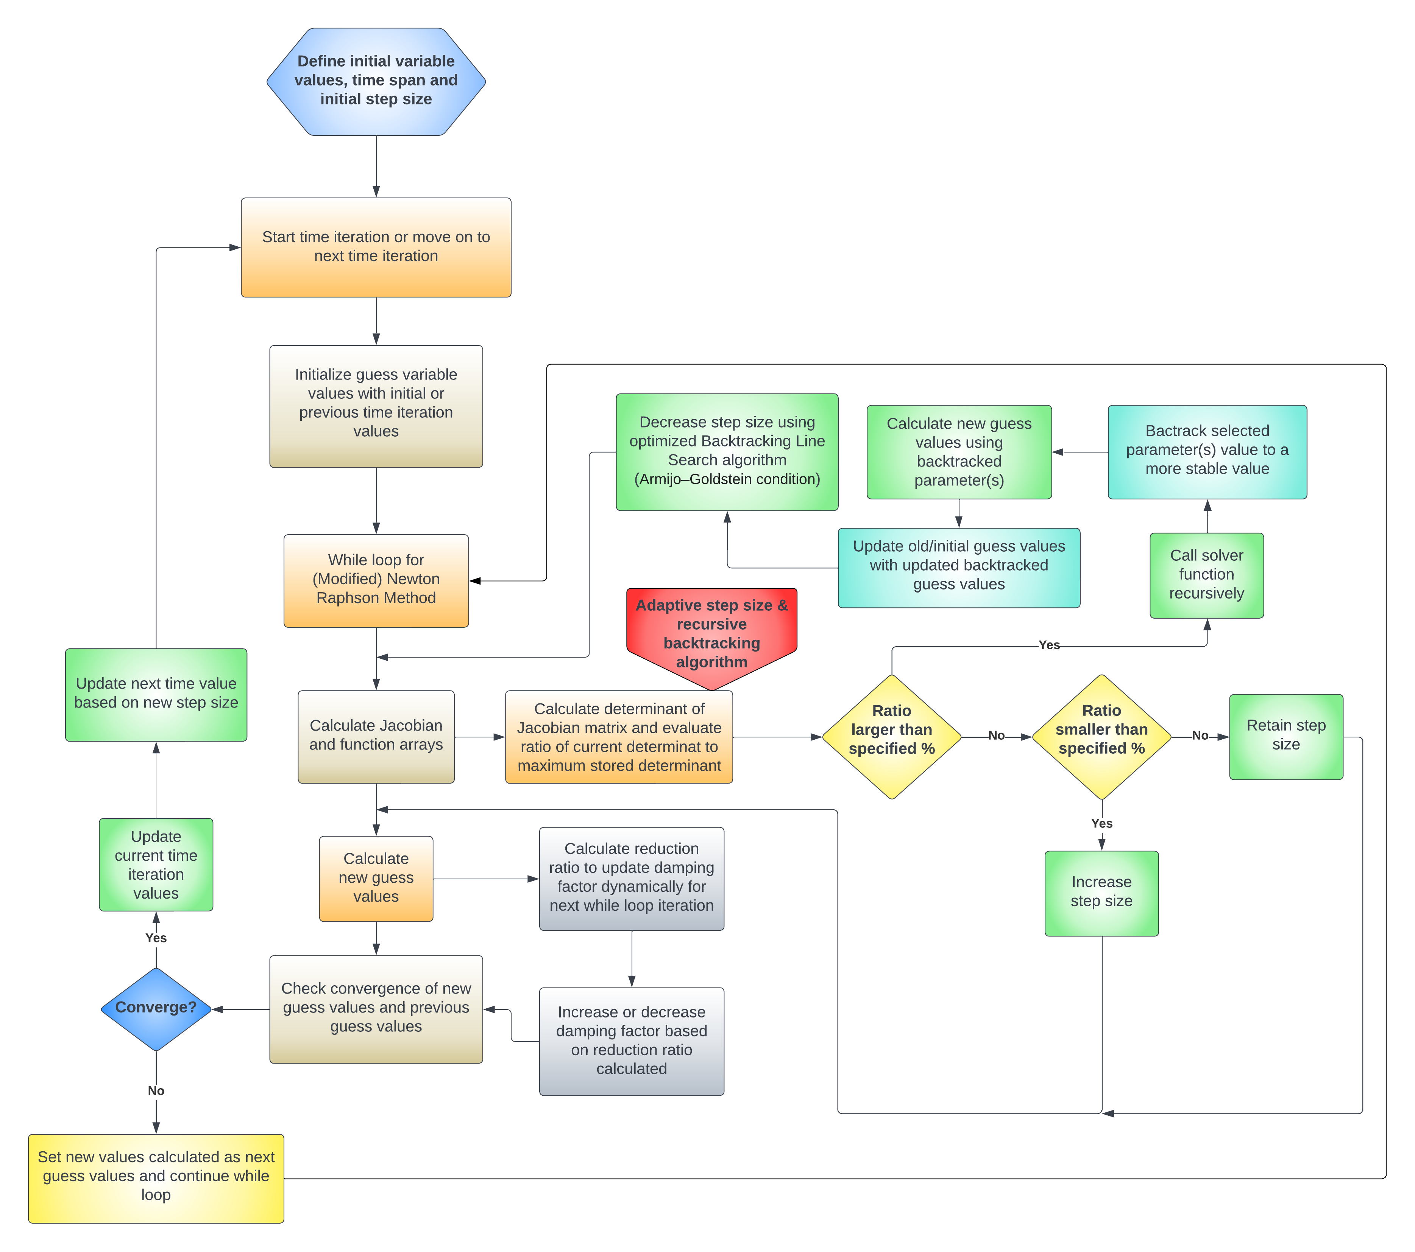
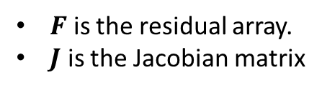
SOLVER ALGORITHM FLOWCHART
System of equations solved via a modified Newton-Rapshon approach:
$$x_{k+1}=x_{k}−αJ^{−1}F$$
$F$ is the residual array.
$J$ is the Jacobian matrix
Slide: 9/26

Slide 14
SOLVER ALGORITHM FLOWCHART
System of equations solved via a modified Newton-Rapshon approach:
$$x_{k+1}=x_{k}−αJ^{−1}F$$
$F$ is the residual array.
$J$ is the Jacobian matrix
Slide: 9/26

Slide 15
SOLVER ALGORITHM FLOWCHART
System of equations solved via a modified Newton-Rapshon approach:
$$x_{k+1}=x_{k}−αJ^{−1}F$$
$F$ is the residual array.
$J$ is the Jacobian matrix
Slide: 9/26

Slide 16
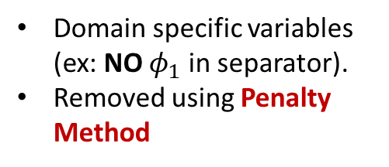

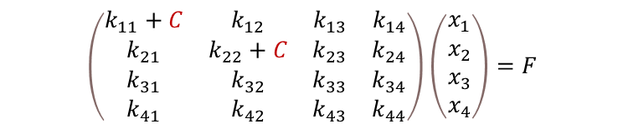
SOLVER ALGORITHM FLOWCHART
Domain specific variables (ex: NO $φ_{1}$ in separator).
Removed using Penalty Method
$$\left(\begin{matrix}k_{11}+C & k_{12} & k_{13} & k_{14} \\ k_{21} & k_{22}+C & k_{23} & k_{24} \\ k_{31} & k_{32} & k_{33} & k_{34} \\ k_{41} & k_{42} & k_{43} & k_{44}\end{matrix}\right)\left(\begin{matrix}x_{1} \\ x_{2} \\ x_{3} \\ x_{4}\end{matrix}\right)=F$$
$$x_{1}→0$$
$$x_{2}→0$$
$$x_{k+1}=x_{k}−αJ^{−1}F$$
$x_{k+1}→x_{k}$ $→x_{0}$
Slide: 10/26

Slide 17
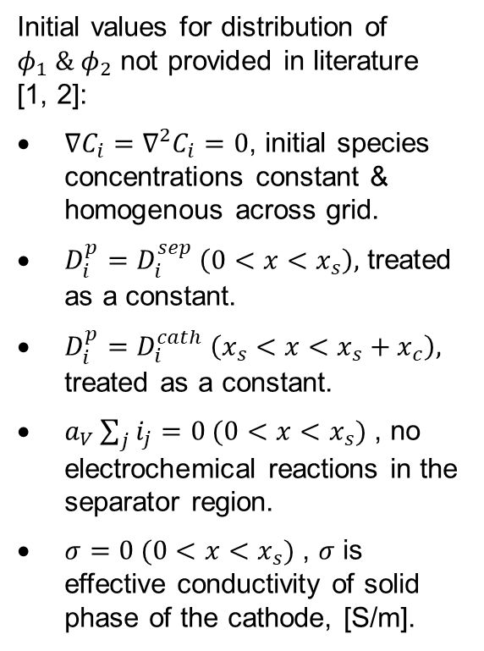
INITIAL VALUE PROBLEM (ELECTROLYTE & SOLID STATE POTENTIALS)
Initial values for distribution of $φ_{1} \& φ_{2}$ not provided in literature [1, 2]:
$∇C_{i}=∇^{2}C_{i}=0$, initial species concentrations constant & homogenous across grid.
$D_{i}^{p}=D_{i}^{sep} \left(0<x<x_{s}\right),$ treated as a constant.
$D_{i}^{p}=D_{i}^{cath} \left(x_{s}<x<x_{s}+x_{c}\right),$ treated as a constant.
$a_{V}\sum_{j}{i_{j}}=0 (0<x<x_{s})$ , no electrochemical reactions in the separator region.
$σ=0 (0<x<x_{s})$ , $σ$ is effective conductivity of solid phase of the cathode, [S/m].
Residual functions discretized:
NOT assumptions, TRUE for future simulations to be discussed.
Slide: 11/26

Slide 18
INITIAL VALUE PROBLEM (ELECTROLYTE & SOLID STATE POTENTIALS)
Initial values for distribution of $φ_{1} \& φ_{2}$ not provided in literature [1, 2]:
$∇C_{i}=∇^{2}C_{i}=0$, initial species concentrations constant & homogenous across grid.
$D_{i}^{p}=D_{i}^{sep} \left(0<x<x_{s}\right),$ treated as a constant.
$D_{i}^{p}=D_{i}^{cath} \left(x_{s}<x<x_{s}+x_{c}\right),$ treated as a constant.
$a_{V}\sum_{j}{i_{j}}=0 (0<x<x_{s})$ , no electrochemical reactions in the separator region.
$σ=0 (0<x<x_{s})$ , $σ$ is effective conductivity of solid phase of the cathode, [S/m].
WHAT’S HAPPENING?
Slide: 11/26

Slide 19
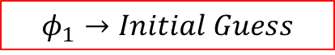
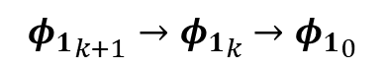
INITIAL VALUE PROBLEM (ELECTROLYTE & SOLID STATE POTENTIALS)
Initial values for distribution of $φ_{1} \& φ_{2}$ not provided in literature [1, 2]:
$∇C_{i}=∇^{2}C_{i}=0$, initial species concentrations constant & homogenous across grid.
$D_{i}^{p}=D_{i}^{sep} \left(0<x<x_{s}\right),$ treated as a constant.
$D_{i}^{p}=D_{i}^{cath} \left(x_{s}<x<x_{s}+x_{c}\right),$ treated as a constant.
$a_{V}\sum_{j}{i_{j}}=0 (0<x<x_{s})$ , no electrochemical reactions in the separator region.
$σ=0 (0<x<x_{s})$ , $σ$ is effective conductivity of solid phase of the cathode, [S/m].
$$φ_{1}→Initial Guess$$
Penalty Method:
${φ_{1}}_{k+1}→{φ_{1}}_{k}$ $→{φ_{1}}_{0}$
Slide: 11/26

Slide 20
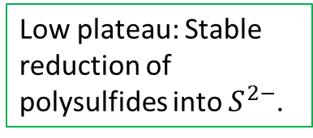
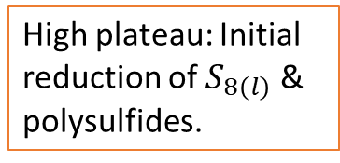
1D Li-S MODEL WITHOUT PRECIPITATION/DISSOLUTION DYNAMICS
High plateau: Initial reduction of $S_{8\left(l\right)}$ & polysulfides.
Remove precipitation/dissolution via: $k_{k}=0$, $R_{k}^{′}=0$
Low plateau: Stable reduction of polysulfides into $S^{2−}$.
Slide: 12/26

Slide 21
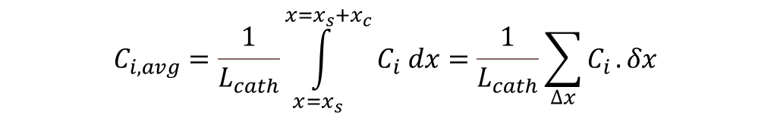
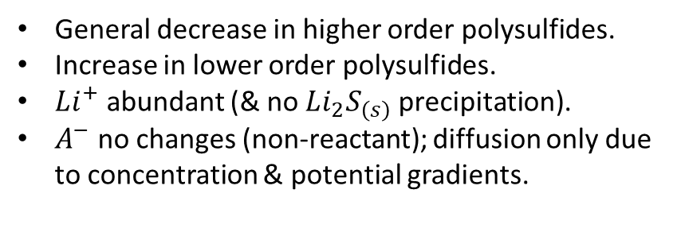
1D Li-S MODEL WITHOUT PRECIPITATION/DISSOLUTION DYNAMICS
$$C_{i, avg}=\frac{1}{L_{cath}}\int_{x=x_{s}}^{x=x_{s}+x_{c}}{C_{i} dx}=\frac{1}{L_{cath}}\sum_{∆x}{C_{i}}.δx$$
General decrease in higher order polysulfides.
Increase in lower order polysulfides.
$Li^{+}$ abundant (& no $Li_{2}S_{\left(s\right)}$ precipitation).
$A^{−}$ no changes (non-reactant); diffusion only due to concentration & potential gradients.
Slide: 13/26

Slide 22
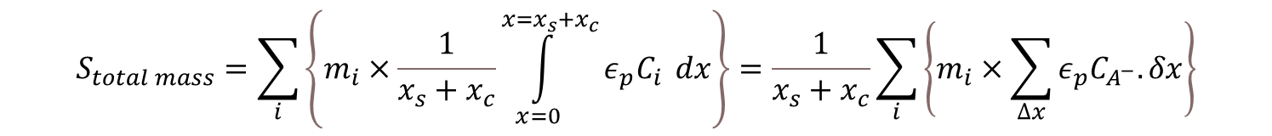
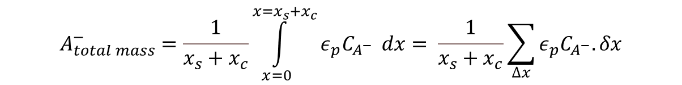
1D Li-S MODEL WITHOUT PRECIPITATION/DISSOLUTION DYNAMICS
$$A_{total mass}^{−}=\frac{1}{x_{s}+x_{c}}\int_{x=0}^{x=x_{s}+x_{c}}{ε_{p}C_{A^{−}}} dx= \frac{1}{x_{s}+x_{c}}\sum_{∆x}{ε_{p}C_{A^{−}}.δx}$$
Neglected as constant multiples.
$$S_{total mass}=\sum_{i}{\left\{m_{i}×\frac{1}{x_{s}+x_{c}}\int_{x=0}^{x=x_{s}+x_{c}}{ε_{p}C_{i}} dx\right\}}=\frac{1}{x_{s}+x_{c}}\sum_{i}{\left\{m_{i}×\sum_{∆x}{ε_{p}C_{A^{−}}.δx}\right\}}$$
Neglected for this study only (requires attention for study WITH precipitation/dissolution.
Slide: 14/26

Slide 23
1D Li-S MODEL WITHOUT PRECIPITATION/DISSOLUTION DYNAMICS
$$A_{total mass}^{−}=\frac{1}{x_{s}+x_{c}}\int_{x=0}^{x=x_{s}+x_{c}}{ε_{p}C_{A^{−}}} dx= \frac{1}{x_{s}+x_{c}}\sum_{∆x}{ε_{p}C_{A^{−}}.δx}$$
$$S_{total mass}=\sum_{i}{\left\{m_{i}×\frac{1}{x_{s}+x_{c}}\int_{x=0}^{x=x_{s}+x_{c}}{ε_{p}C_{i}} dx\right\}}=\frac{1}{x_{s}+x_{c}}\sum_{i}{\left\{m_{i}×\sum_{∆x}{ε_{p}C_{A^{−}}.δx}\right\}}$$
Only viable for WITHOUT precipitation/dissolution.
Slide: 15/26

Slide 24
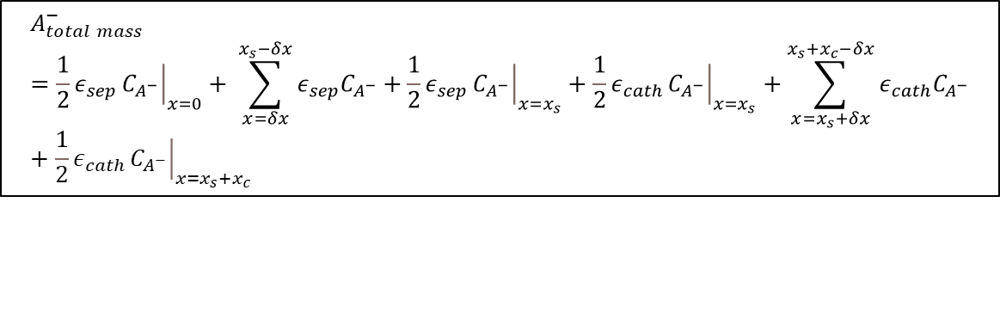

1D Li-S MODEL WITH PRECIPITATION/DISSOLUTION DYNAMICS
$$A_{total mass}^{−}=\frac{1}{2}ε_{sep}{\left.C_{A^{−}}\right|}_{x=0}+ \sum_{x=δx}^{x_{s}−δx}{ε_{sep}C_{A^{−}}}+\frac{1}{2}ε_{sep}{\left.C_{A^{−}}\right|}_{x=x_{s}}+\frac{1}{2}ε_{cath}{\left.C_{A^{−}}\right|}_{x=x_{s}}+\sum_{x=x_{s}+δx}^{x_{s}+x_{c}−δx}{ε_{cath}C_{A^{−}}}+\frac{1}{2}ε_{cath}{\left.C_{A^{−}}\right|}_{x=x_{s}+x_{c}}$$
Li-S 1D Model Grid
$$i_{e,sep}=i_{e,cath}$$
Full cell
Half-cell
Slide: 16/26

Slide 25
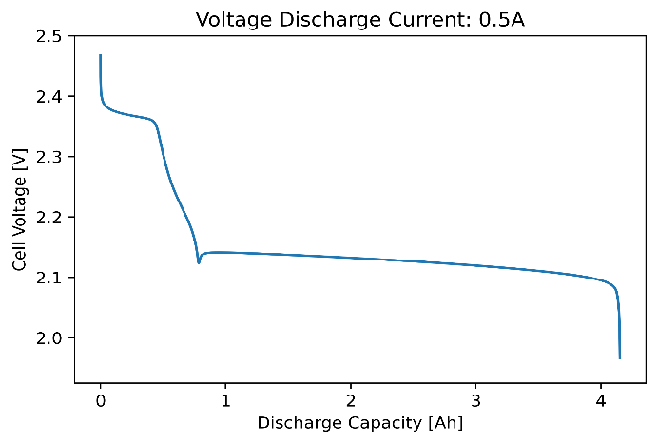
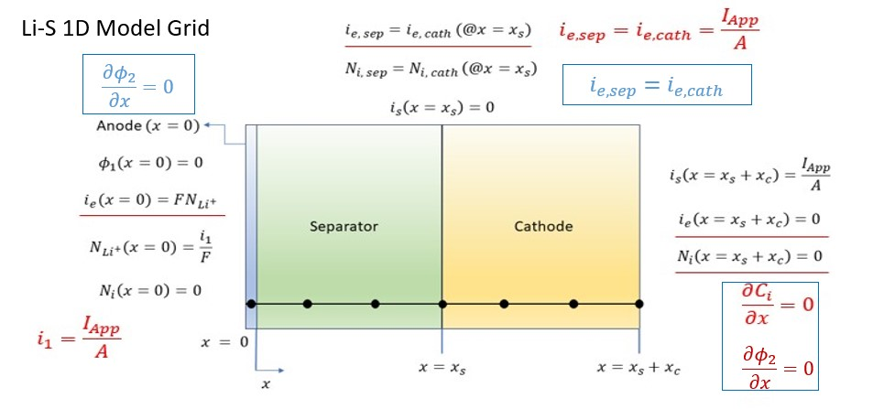
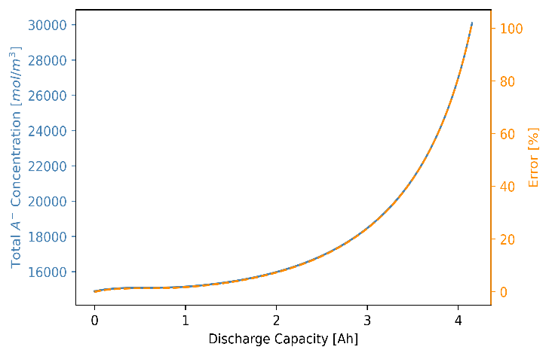
1D Li-S MODEL WITH PRECIPITATION/DISSOLUTION DYNAMICS
Slide: 17/26

Slide 26
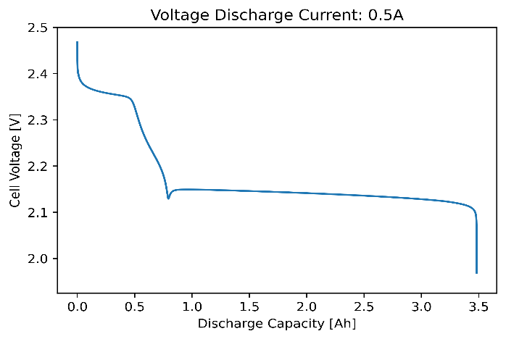
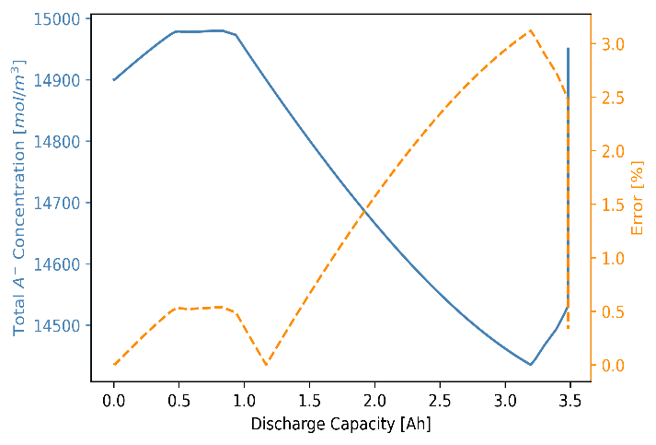
1D Li-S MODEL WITH PRECIPITATION/DISSOLUTION DYNAMICS
Slide: 18/26

Slide 27
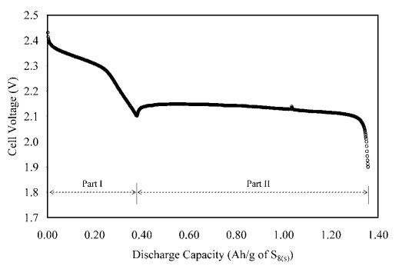
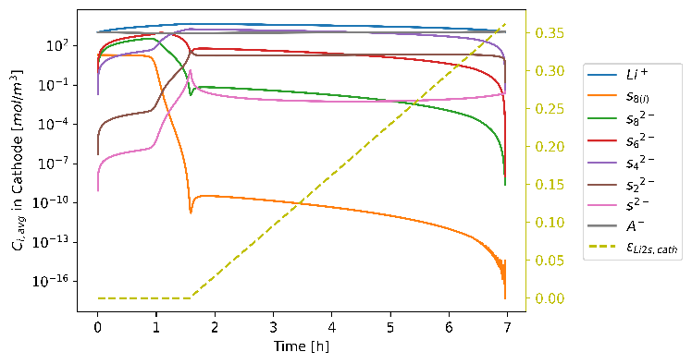
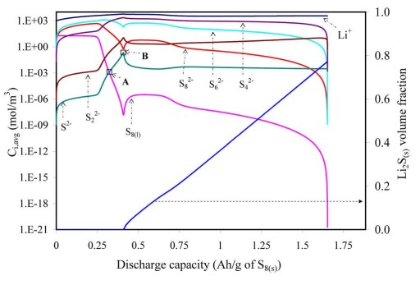
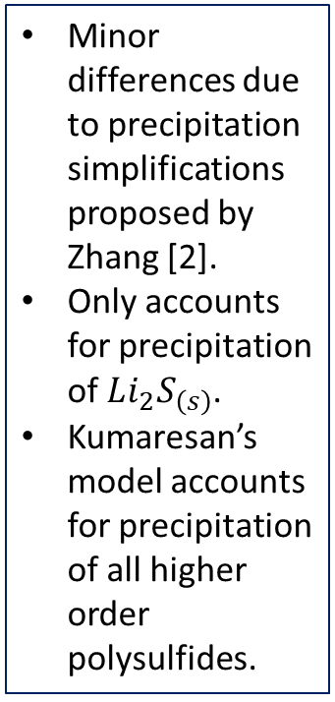
1D Li-S MODEL WITH PRECIPITATION/DISSOLUTION DYNAMICS
Minor differences due to precipitation simplifications proposed by Zhang [2].
Only accounts for precipitation of $Li_{2}S_{\left(s\right)}$.
Kumaresan’s model accounts for precipitation of all higher order polysulfides.
Comparison of plots from Kumaresan and results from novel solver. Experimental, C = 2.5 Ah discharge profile [top right] [1] and species evolution in cathode [bottom right] [1].
Slide: 19/26

Slide 28
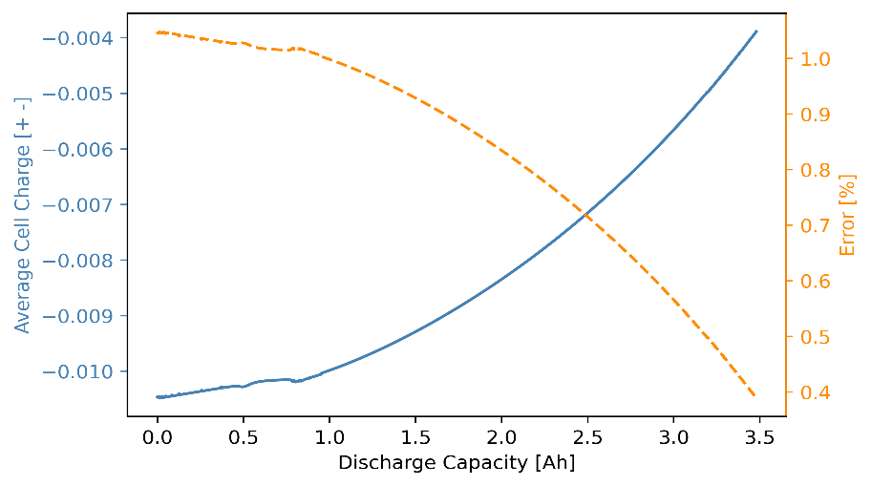

1D Li-S MODEL WITH PRECIPITATION/DISSOLUTION DYNAMICS
$$\sum_{i}{ε_{p}z_{i}C_{i}}=0$$
$$\sum_{i}{z_{i}\left[\frac{1}{2}ε_{sep}{\left.C_{i}\right|}_{x=0}+ \sum_{x=δx}^{x_{s}−δx}{ε_{sep}C_{i}}+\frac{1}{2}ε_{sep}{\left.C_{i}\right|}_{x=x_{s}}+\frac{1}{2}ε_{cath}{\left.C_{i}\right|}_{x=x_{s}}+\sum_{x=x_{s}+δx}^{x_{s}+x_{c}−δx}{ε_{cath}C_{i}}+\frac{1}{2}ε_{cath}{\left.C_{i}\right|}_{x=x_{s}+x_{c}}\right]}$$
Slide: 20/26

Slide 29
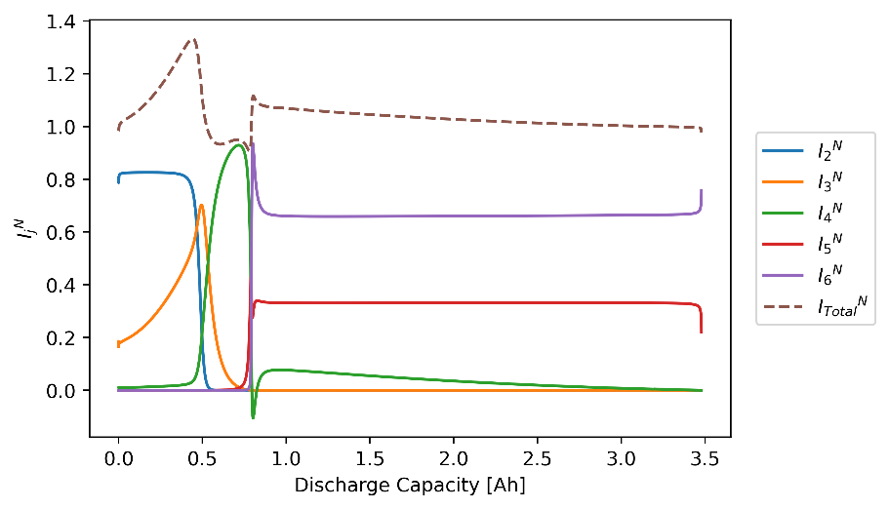


1D Li-S MODEL WITH PRECIPITATION/DISSOLUTION DYNAMICS
$$I_{j}^{N}=\frac{1}{\frac{I_{App}}{A}}\int_{x=x_{s}}^{x=x_{s}+x_{c}}{a_{v}i_{j} dx}=\frac{1}{\frac{I_{App}}{A}}\sum_{∆x}{a_{v}i_{j}δx}$$
Ghaznavi & Chen [3] findings suggest cathodic normalized partial add to unity (employing full Kumaresan model).
Not what is observed here (mainly at high plateau region).
Reason due to precipitation simplifications.
Dissolution acts as ‘source’ to charge density.
Precipitation acts as ‘sink’.
Precipitation/dissolution reach equilibrium in low plateau (add to unity).
$$\sum_{j=2}^{6}{I_{j}^{N}}=1$$
Slide: 21/26

Slide 30
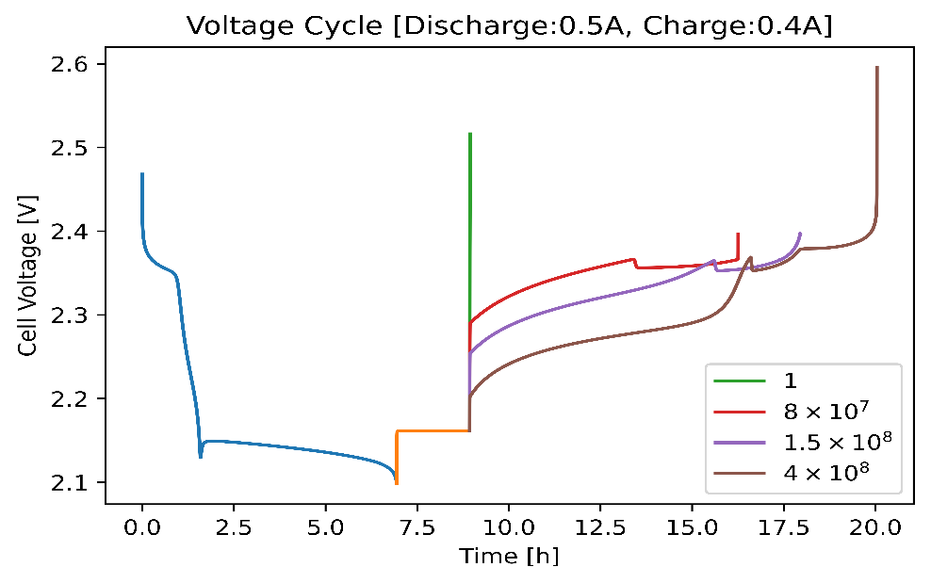
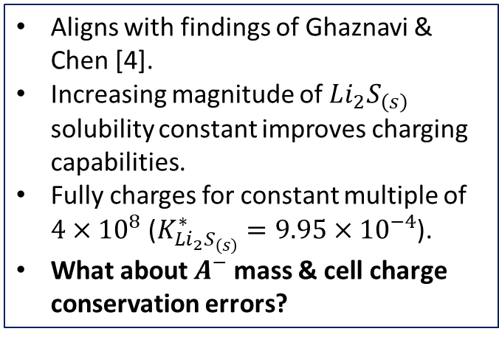
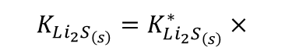
CONSECUTIVE CHARGE TEST
Aligns with findings of Ghaznavi & Chen [4].
Increasing magnitude of $Li_{2}S_{\left(s\right)}$ solubility constant improves charging capabilities.
Fully charges for constant multiple of $4×{10}^{8}$ ($K_{Li_{2}S_{\left(s\right)}}^{∗}=9.95×{10}^{−4}$).
What about $A^{−}$mass & cell charge conservation errors?
Rest = 0A
$$K_{Li_{2}S_{\left(s\right)}}=K_{Li_{2}S_{\left(s\right)}}^{∗}×$$
Slide: 22/26

Slide 31
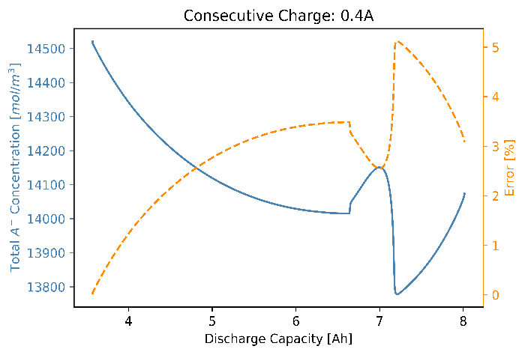
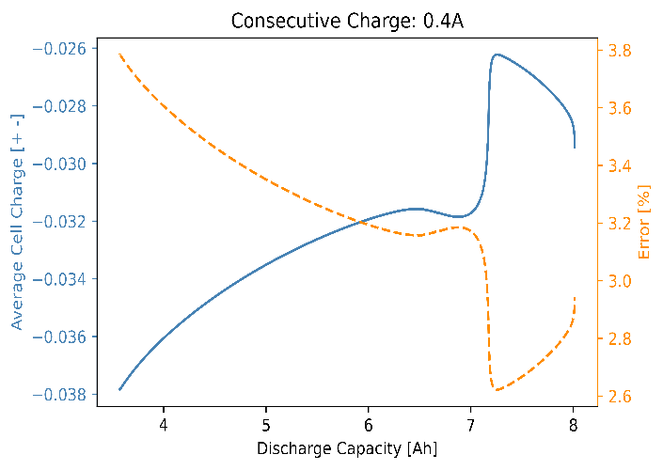
CONSECUTIVE CHARGE TEST
Rest = 0A
$$K_{Li_{2}S_{\left(s\right)}}=K_{Li_{2}S_{\left(s\right)}}^{∗}×$$
Slide: 22/26

Slide 32
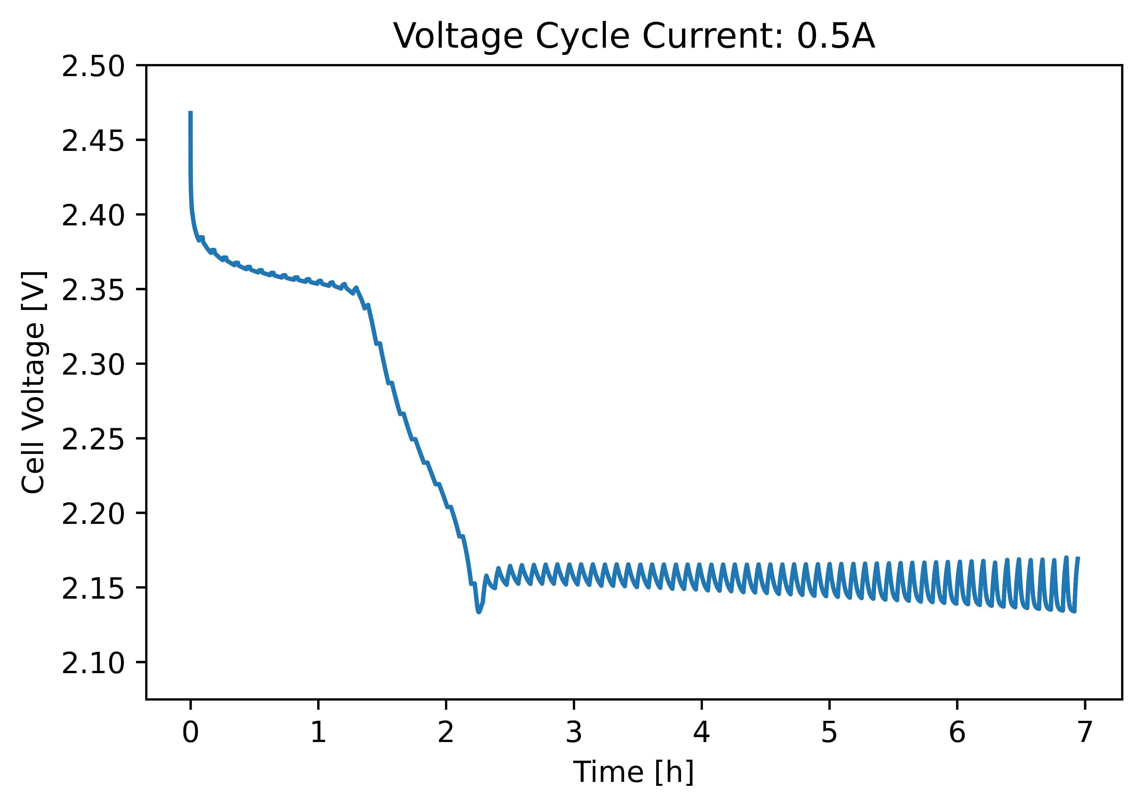
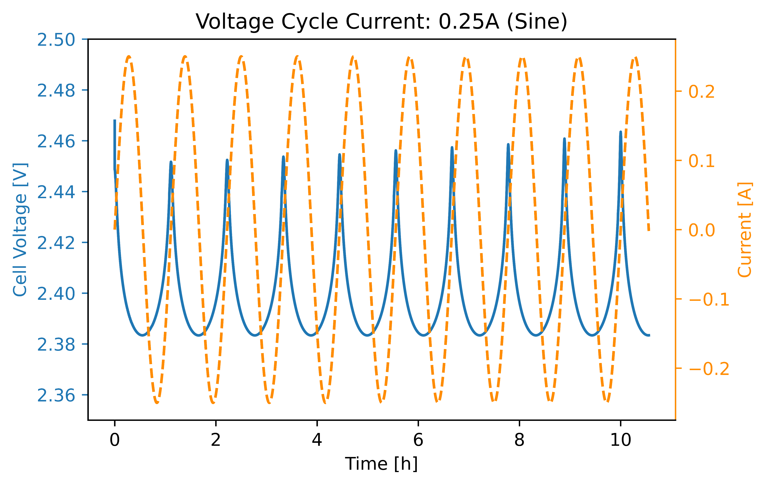
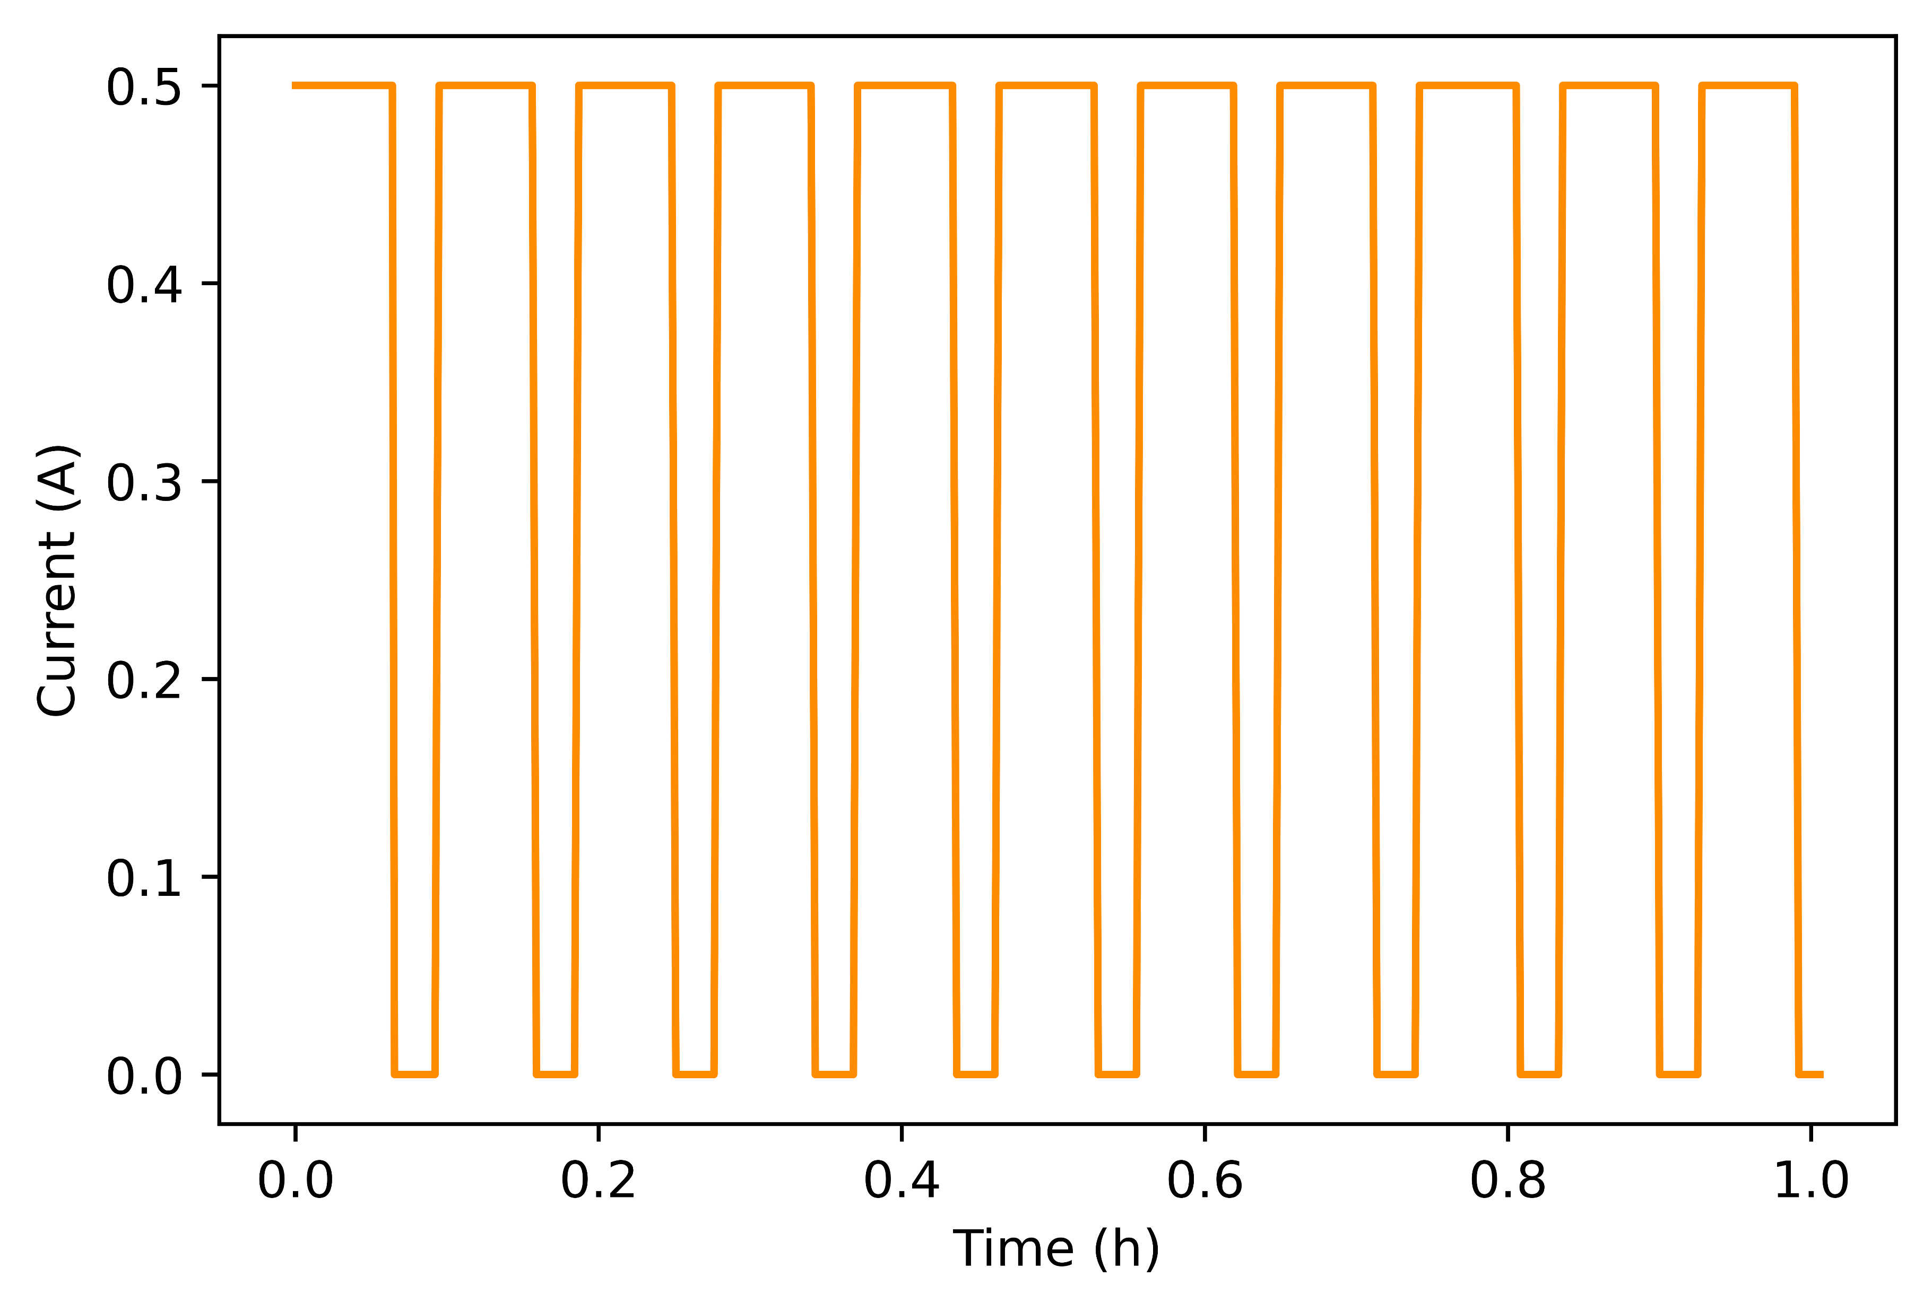
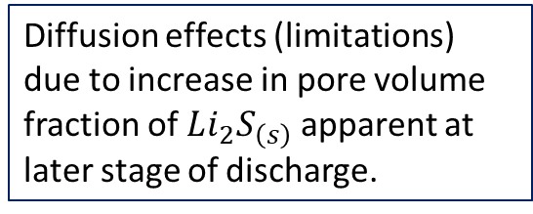
GITT & NON-CONSTANT CURRENT TESTS
Diffusion effects (limitations) due to increase in pore volume fraction of $Li_{2}S_{\left(s\right)}$ apparent at later stage of discharge.
Slide: 23/26

Slide 33
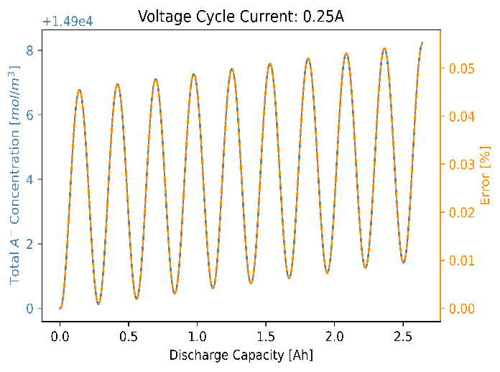
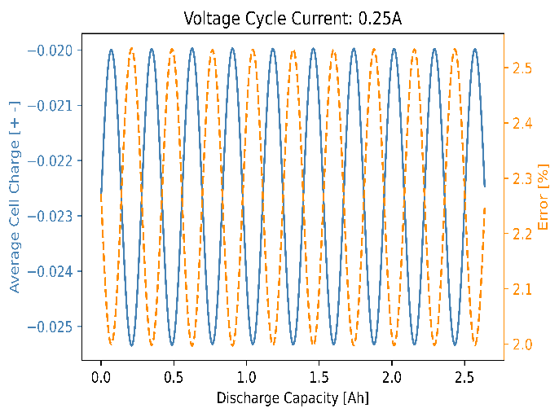
GITT & NON-CONSTANT CURRENT TESTS
Relatively small errors.
Success of the solver in simulating varied operating conditions.
Efficient with average simulation runtime: 10mins.
Slide: 24/26

Slide 34
REFERENCES
Kumaresan K, Mikhaylik Y, White RE. A Mathematical Model for a Lithium–Sulfur Cell. Journal of The Electrochemical Society. 2008;155(8): A576. https://doi.org/10.1149/1.2937304.
Zhang T, Marinescu M, Walus S, Offer GJ. Modelling transport-limited discharge capacity of lithium-sulfur cells. Electrochimica Acta. 2016;219: 502–508. https://doi.org/10.1016/j.electacta.2016.10.032.
Ghaznavi M, Chen P. Sensitivity analysis of a mathematical model of lithium-sulfur cells part I: Applied discharge current and cathode conductivity. Journal of Power Sources. 2014;257: 394–401. https://doi.org/10.1016/j.jpowsour.2013.10.135.
Ghaznavi M, Chen P. Analysis of a Mathematical Model of Lithium-Sulfur Cells Part III: Electrochemical Reaction Kinetics, Transport Properties and Charging. Electrochimica Acta. 2014;137: 575–585. https://doi.org/10.1016/j.electacta.2014.06.033.
D. Sugunan. FUSE_Li-S_Battery_Modelling. Github; 2023 [Accessed 24th March 2024]. Available from: https://github.com/Dharshannan/FUSE_Li-S_Battery_Modelling.
Slide: 25/26

Slide 35

THANK YOU FOR LISTENING & WELCOME ANY QUESTIONS !!!
SCAN TO ACCESS GITHUB REPOSITORY CONTAINING PYTHON SCRIPTS:
Slide: 26/26

Slide 36
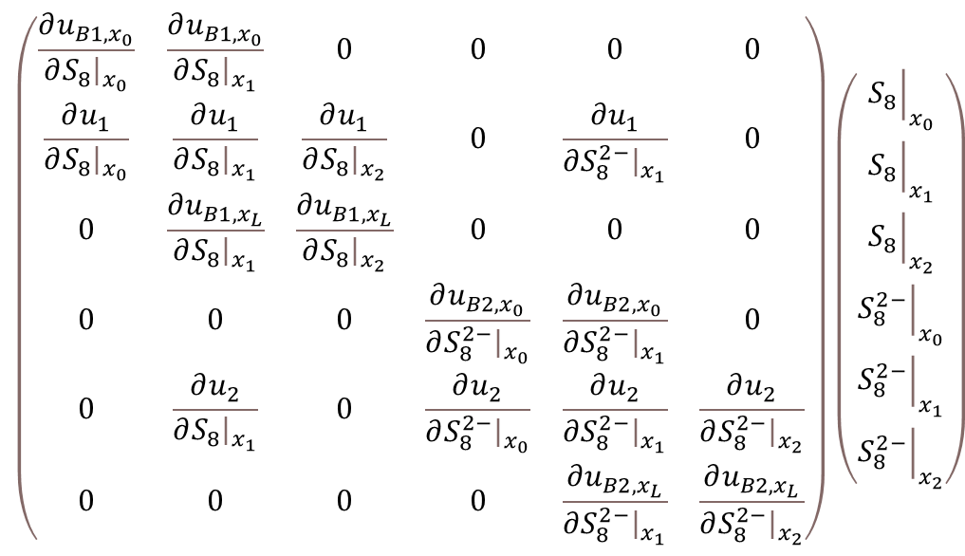
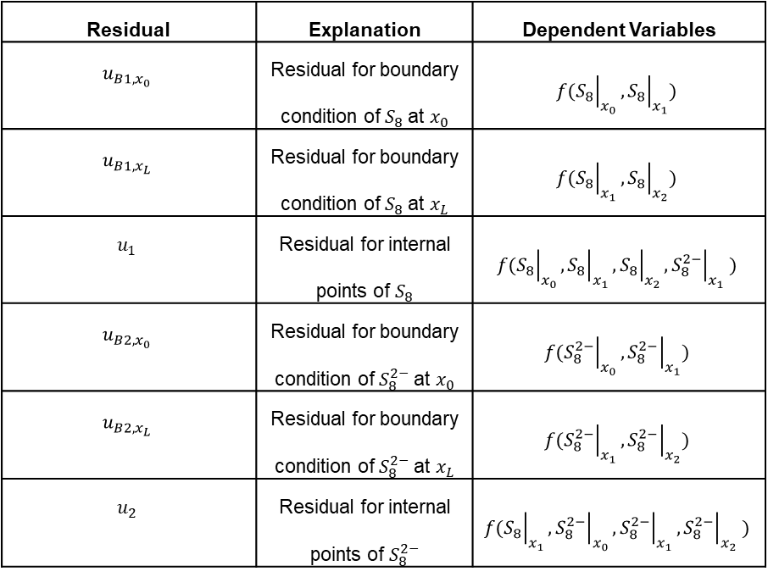

APPENDIX
A simple demonstration of how the Jacobian matrix is formed for 2 boundary points and 1 internal point with 2 variables ($S_{8} \& S_{8}^{2−})$ is provided as follows. Note the variable vector is provided only for sequence visualization purposes next to the Jacobian matrix, where $x_{0} \& (x_{2}=x_{L})$ are the boundary points while $x_{1}$ is the internal point:
Residual | Explanation | Dependent Variables
$$u_{B1,x_{0}}$$ | Residual for boundary condition of $S_{8}$at $x_{0}$ | $$f({\left.S_{8}\right|}_{x_{0}}, {\left.S_{8}\right|}_{x_{1}})$$
$$u_{B1,x_{L}}$$ | Residual for boundary condition of $S_{8}$at $x_{L}$ | $$f({\left.S_{8}\right|}_{x_{1}}, {\left.S_{8}\right|}_{x_{2}})$$
$$u_{1}$$ | Residual for internal points of $S_{8}$ | $$f({\left.S_{8}\right|}_{x_{0}}, {\left.S_{8}\right|}_{x_{1}}, {\left.S_{8}\right|}_{x_{2}},{\left.S_{8}^{2−}\right|}_{x_{1}} )$$
$$u_{B2,x_{0}}$$ | Residual for boundary condition of $S_{8}^{2−}$at $x_{0}$ | $$f({\left.S_{8}^{2−}\right|}_{x_{0}}, {\left.S_{8}^{2−}\right|}_{x_{1}})$$
$$u_{B2,x_{L}}$$ | Residual for boundary condition of $S_{8}^{2−}$at $x_{L}$ | $$f({\left.S_{8}^{2−}\right|}_{x_{1}}, {\left.S_{8}^{2−}\right|}_{x_{2}})$$
$$u_{2}$$ | Residual for internal points of $S_{8}^{2−}$ | $$f({\left.S_{8}\right|}_{x_{1}}, {\left.S_{8}^{2−}\right|}_{x_{0}}, {\left.S_{8}^{2−}\right|}_{x_{1}},{\left.S_{8}^{2−}\right|}_{x_{2}} )$$
$$\left(\begin{matrix}\frac{∂u_{B1,x_{0}}}{∂{\left.S_{8}\right|}_{x_{0}}} & \frac{∂u_{B1,x_{0}}}{∂{\left.S_{8}\right|}_{x_{1}}} & 0 & 0 & 0 & 0 \\ \frac{∂u_{1}}{∂{\left.S_{8}\right|}_{x_{0}}} & \frac{∂u_{1}}{∂{\left.S_{8}\right|}_{x_{1}}} & \frac{∂u_{1}}{∂{\left.S_{8}\right|}_{x_{2}}} & 0 & \frac{∂u_{1}}{∂{\left.S_{8}^{2−}\right|}_{x_{1}}} & 0 \\ 0 & \frac{∂u_{B1,x_{L}}}{∂{\left.S_{8}\right|}_{x_{1}}} & \frac{∂u_{B1,x_{L}}}{∂{\left.S_{8}\right|}_{x_{2}}} & 0 & 0 & 0 \\ 0 & 0 & 0 & \frac{∂u_{B2,x_{0}}}{∂{\left.S_{8}^{2−}\right|}_{x_{0}}} & \frac{∂u_{B2,x_{0}}}{∂{\left.S_{8}^{2−}\right|}_{x_{1}}} & 0 \\ 0 & \frac{∂u_{2}}{∂{\left.S_{8}\right|}_{x_{1}}} & 0 & \frac{∂u_{2}}{∂{\left.S_{8}^{2−}\right|}_{x_{0}}} & \frac{∂u_{2}}{∂{\left.S_{8}^{2−}\right|}_{x_{1}}} & \frac{∂u_{2}}{∂{\left.S_{8}^{2−}\right|}_{x_{2}}} \\ 0 & 0 & 0 & 0 & \frac{∂u_{B2,x_{L}}}{∂{\left.S_{8}^{2−}\right|}_{x_{1}}} & \frac{∂u_{B2,x_{L}}}{∂{\left.S_{8}^{2−}\right|}_{x_{2}}}\end{matrix}\right)\left(\begin{matrix}{\left.S_{8}\right|}_{x_{0}} \\ {\left.S_{8}\right|}_{x_{1}} \\ {\left.S_{8}\right|}_{x_{2}} \\ {\left.S_{8}^{2−}\right|}_{x_{0}} \\ {\left.S_{8}^{2−}\right|}_{x_{1}} \\ {\left.S_{8}^{2−}\right|}_{x_{2}}\end{matrix}\right)$$
Slide: AP1

Slide 37









APPENDIX
$$\sum_{j=2}^{6}{I_{j}^{N}}=1$$
At the start of discharge, the sum of normalized currents increases, unlike results by Ghaznavi and Chen [3].
This is theorized to be due to the initial dissolution of $S_{8\left(s\right)}$ into polysulfide anions, increasing overall charge density.
Ghaznavi and Chen's results differ likely because they used the full Kumaresan model, accounting for precipitation of all polysulfide species.
The simplified model here only accounts for the precipitation of $Li^{2}S_{(s)}$ as proposed by Zhang.
Precipitation of higher-order polysulfides reduces charge density, balancing the increase from S₈(s) dissolution, which is observed in Ghaznavi and Chen's model but not in the simplified one.
The drop in normalized currents near the high-to-low plateau transition is due to initial $Li^{2}S_{\left(s\right)}$ precipitation acting as a ‘sink’.
The sum of the currents stabilizes and reaches unity as the precipitation/dissolution reactions reach equilibrium in the low plateau region.
0.5A Discharge Results, $L_{sep}:L_{cath}=1:1$
0.5A Discharge Results, $L_{sep}:L_{cath}=1:5$
Ghaznavia & Chen [3]
0.1A Discharge Results, $L_{sep}:L_{cath}=1:1$
Slide: AP2

Slide 38





APPENDIX
Reduction of active material in the cathode, due to precipitation of $Li_{2}S_{\left(s\right)}$
Diffusion limitations due to increase in pore volume fraction of $Li_{2}S_{\left(s\right)}$ apparent at later stage of discharge.
Slide: AP3

